Slide 1

Technology: Python
ANALYSIS OF WOMEN SAFETY IN INDIAN CITIES USING ML ON TWEETS

Slide 2
INDEX
Abstract
Introduction
Existing Method
Proposed method
Block Diagram
Requirements
Functional requirements
Non - Functional requirements
Software requirements
Architecture
Algorithm
System Design

Slide 3
ABSTRACT
Women and girls in Indian cities face significant challenges such as stalking, sexual harassment, and assault in public spaces. This research explores the role of social media platforms like Twitter, Facebook, and Instagram in promoting women’s safety and raising awareness. Social media serves as a tool to disseminate messages, quotes, and stories, educating the youth and encouraging strict action against offenders. Women often use platforms like Twitter to express their feelings about safety while commuting or working, sharing their experiences through hashtags that reach a global audience.
To analyze these sentiments, this study employs machine learning algorithms, including Support Vector Machine (SVM), Neural Networks, Gradient Boosting, Random Forest, Decision Tree, Naive Bayes, and K-Nearest Neighbors (KNN). These models classify tweets into positive, negative, or neutral sentiments while assessing their performance using metrics like accuracy, precision, and recall.
This research highlights how technology and societal responsibility can promote women's safety. By leveraging machine learning and social media, it emphasizes the need for collective action to create safer environments for women.
Keywords: Women’s safety, social media, Twitter, machine learning, SVM, Neural Networks, Gradient Boosting, Random Forest, Decision Tree, Naive Bayes, KNN, sentiment analysis.

Slide 4
INTRODUCTION
Twitter has emerged as the ultimate microblogging social network in the modern era, with over 100 million users and over 500 million 'Tweets' sent every day. With such a large audience, Twitter has attracted users to share their opinions and judgments on every existing issue and topic on the internet; as a result, Twitter is an informative source for all sectors such as institutions, businesses, and organizations.
In the tweets section of Twitter, users will share their thoughts and opinions. Because this tweet has a character limit of 140 characters, users must condense their messages using abbreviations, slang, shot forms, emoticons, and other techniques. In addition, many people use polysemy and sarcasm to express themselves. As a result, Twitter language is classified as unstructured. The sentiment underlying the message is derived from the tweet. The sentimental analysis procedure is used to extract this data.
The sentiment analysis results can be used in a variety of contexts, such as analysing public opinion on government policies, people's attitudes toward women, and so on. A great deal of research has been done on the data obtained by twitter in order to perform tweet classification and analyse the results.

Slide 5
In this paper, we also review some machine learning studies as well as research on how to perform sentiment analysis on Twitter data using that domain. The focus of the paper is on machine learning algorithms and models.
Staring at women and making comments can be considered forms of violence and harassment, and these practises, while unacceptable, are common, particularly in urban areas. Many studies conducted in India show that women have reported sexual harassment and other practises such as those mentioned above. Such studies have also revealed that in popular metropolitan cities such as Delhi, Pune, Chennai, and Mumbai, most women feel unsafe when they are surrounded by strangers. People can freely express themselves on social media about Indian politics, society, and a variety of other topics. Similarly, women can share their experiences if they have faced violence or sexual harassment, bringing innocent people together to fight back on these occurrences According to the analysis of tweets text collection obtained by Twitter, it includes names of people who have harassed women, as well as names of women or innocent people who have stood up to such violent acts or unethical behaviour by men, making them feel uncomfortable walking freely in public.

Slide 6
LITERATURE REVIEW
S. No | Journal Type with year | Authors | Title | Outcomes
1 | EACL, 2009 | Agarwal, Apoorv, Fadi Biadsy, and Kathleen R. Mckeown | Contextual phrase-level polarity analysis using lexical affect scoring and syntactic n-grams | In this paper, demonstrate a considerable improvement over both a majority class baseline and a more challenging baseline comprised of lexical n-grams
2 | ICIKM, 2010 | Bermingham, Adam, and Alan F. Smeaton | Classifying sentiment in microblogs: is brevity an advantage | In this paper, we test the premise that sentiment is simpler to categorise in short form papers than in longer form documents.
3 | IJIRAE, 2015 | Sahayak, V., Shete, V., & Pathan, A. | Sentiment analysis on twitter data | we will examine the existing analysis of the Twitter dataset utilising a data mining technique, such as the usage of Sentiment analysis algorithms and machine learning algorithms.
4 | ICCTICT, 2016 | Mamgain, N., Mehta, E., Mittal, A., & Bhatt, G. | Sentiment analysis of top colleges in India using Twitter data | In this paper, compares the results produced by using the following machine learning algorithms: Nave Bayes and Support Vector Machine, as well as an Artificial Neural Network model: Multilayer Perceptron.

Slide 7
EXISTING METHOD
When we consider these systems were previously, they used to find the records manually which leads to waste they no fast response in the case and they need to search each and everything were as in previous system they don’t have the awareness about the technology due to that many women lost their life valuable life so to reduce the crime against the women we are implementing different system.
Dis Advantages:
More time
It’s difficult to find them
Less efficiency

Slide 8
PROPOSED METHOD
When we consider now due rapid change in the society. The people have more awareness against such kinds of crimes. Now they need to maintain the records manually everything can be maintained and we can find out the criminal easily by using these we can find his enter details of him and we can punish him. And we can also find the previous records. Here we are implementing using the ML based algorithms are Ada boosting, Cat boosting, SVM and Naïve Bayes. These algorithms are used for training the dataset from which we can predict the output.
Advantages:
Less time
More accurate result
More efficiency

Slide 9
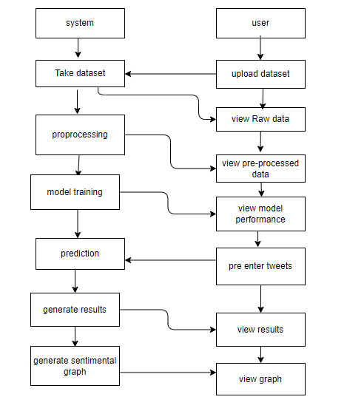
BLOCK DIAGRAM

Slide 10
IMPLEMENTATION
Install the required packages
Defining the problem association.
Create a Django based User Interface.
Runs restaurant and user modules.

Slide 11
SYSTEM REQUIREMENTS
Functional and non-functional requirements:
Requirement’s analysis is very critical process that enables the success of a system or software project to be assessed. Requirements are generally split into two types: Functional and non-functional requirements.
Functional Requirements:
These are the requirements that the end user specifically demands as basic facilities that the system should offer. All these functionalities need to be necessarily incorporated into the system as a part of the contract. These are represented or stated in the form of input to be given to the system, the operation performed and the output expected. They are basically the requirements stated by the user which one can see directly in the final product, unlike the non-functional requirements.

Slide 12
Examples of functional requirements:
Authentication of user whenever he/she logs into the system
System shutdown in case of a cyber-attack
Verification email is sent to user whenever he/she register for the first time on some software system.
Non-functional requirements:
These are basically the quality constraints that the system must satisfy according to the project contract. The priority or extent to which these factors are implemented varies from one project to other. They are also called non-behavioral requirements. They basically deal with issues like:
Portability
Security
Maintainability

Slide 13
Reliability
Scalability
Performance
Reusability
Flexibility
Examples of non-functional requirements:
Emails should be sent with a latency of no greater than 12 hours from such an activity.
The processing of each request should be done within 10 seconds.
The site should load in 3 seconds whenever of simultaneous users are > 10000.

Slide 14
S/W Requirements:
• Operating System : Windows 10 .
• IDE : Pycharm
• Libraries Used : Numpy, OS, IO, Keras, Tensorflow .
• Technology : Python 3.6

Slide 15
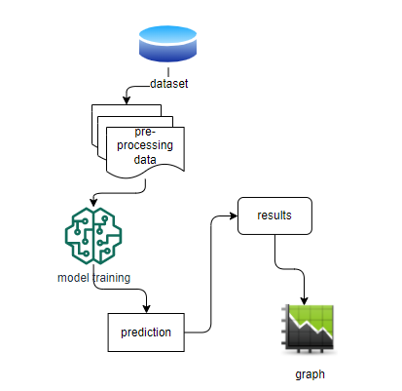
ARCHITECTURE

Slide 16
SYSTEM DESIGN
MODULES
SYSTEM
1. Upload Dataset:
This module is concerned with uploading the csv file on the Project where the dataset is a twitter csv file that contains tweet id , date of creation, text, url , latitude , longitude, followers, following and other relevant information.
2. Data Pre-processing:
This Module is meant for removing unnecessary features or columns that has maximum null values. Since most of them are null values, they doesn't convey any information or has impact on the output target variable. This module is also connected with consolidating the values as per the tweet id like no of tweets, age, no of followers, no of following, retweets, favourites and plenty other information.

Slide 17
3. Bag of words Module:
In this model we are going to create models Bag of words for each class separately. Here the classes are POSITIVE, NEUTRAL and NEGATIVE. Here NEGATIVE stands for a junk tweet and POSITIVE stands for a legitimate Tweet. From this BOW we are going to generate top 10 words from each class so as to know the most frequent words in the Tweets.
4. Training the Model:
This Module is meant for creating a Model (s) as per the problem statement. Before this creation we are going to split the given data into two parts: Train and Test. Here train data is used for fitting or training the module.

Slide 18
USER
5. Validating the Model:
Using Test data obtained from previous module we are going to test or validate the model for accuracy. Classification report is another measure which consolidates all the above metrics.
6. Tables/ Graphs:
This module is concerned with generating the reports or graphs or tables as per the results obtained from training and testing the model.

Slide 19
UML DIAGRAMS
Uml stands for unified modeling language. Uml is a standardized general-purpose modeling language in the field of object-oriented software engineering. The standard is managed, and was created by, the object management group.
The goal is for uml to become a common language for creating models of object oriented computer software. In its current form uml is comprised of two major components: a meta-model and a notation. In the future, some form of method or process may also be added to; or associated with, uml.
The unified modeling language is a standard language for specifying, visualization, constructing and documenting the artifacts of software system, as well as for business modeling and other non-software systems.
The uml represents a collection of best engineering practices that have proven successful in the modeling of large and complex systems.

Slide 20
The uml is a very important part of developing objects oriented software and the software development process. The uml uses mostly graphical notations to express the design of software projects.
Use case diagram:
A use case diagram in the unified modeling language (uml) is a type of behavioral diagram defined by and created from a use-case analysis. Its purpose is to present a graphical overview of the functionality provided by a system in terms of actors, their goals (represented as use cases), and any dependencies between those use cases. The main purpose of a use case diagram is to show what system functions are performed for which actor. Roles of the actors in the system can be depicted.

Slide 21
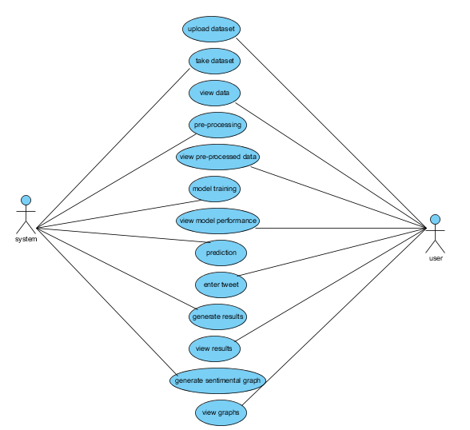

Slide 22
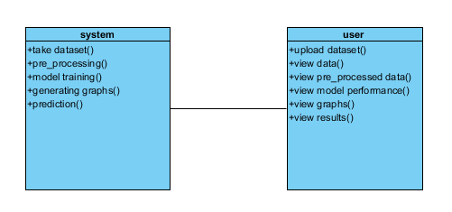
Class diagram:
In software engineering, a class diagram in the unified modeling language (uml) is a type of static structure diagram that describes the structure of a system by showing the system's classes, their attributes, operations (or methods), and the relationships among the classes. It explains which class contains information.

Slide 23
Sequence diagram:
A sequence diagram in unified modeling language (uml) is a kind of interaction diagram that shows how processes operate with one another and in what order. It is a construct of a message sequence chart. Sequence diagrams are sometimes called event diagrams, event scenarios, and timing diagrams.

Slide 24
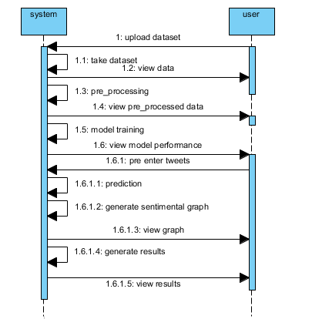

Slide 25
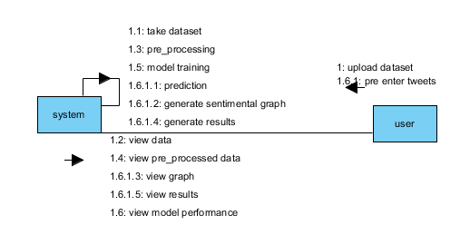
Collaboration diagram:
In collaboration diagram the method call sequence is indicated by some numbering technique as shown below. The number indicates how the methods are called one after another. We have taken the same order management system to describe the collaboration diagram. The method calls are similar to that of a sequence diagram. But the difference is that the sequence diagram does not describe the object organization whereas the collaboration diagram shows the object organization.

Slide 26
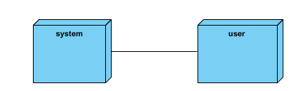
Deployment diagram:
Deployment diagram represents the deployment view of a system. It is related to the component diagram. Because the components are deployed using the deployment diagrams. A deployment diagram consists of nodes. Nodes are nothing but physical hard ware’s used to deploy the application.

Slide 27
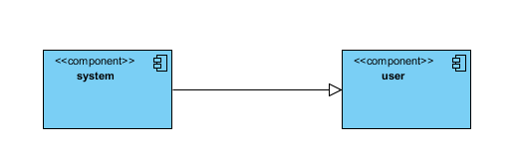
Component diagram:
Component diagrams are used to describe the physical artifacts of a system. This artifact includes files, executable, libraries etc. So the purpose of this diagram is different, component diagrams are used during the implementation phase of an application. But it is prepared well in advance to visualize the implementation details. Initially the system is designed using different uml diagrams and then when the artifacts are ready component diagrams are used to get an idea of the implementation.

Slide 28
Activity diagram:
Activity diagrams are graphical representations of workflows of stepwise activities and actions with support for choice, iteration and concurrency. In the unified modeling language, activity diagrams can be used to describe the business and operational step-by-step workflows of components in a system. An activity diagram shows the overall flow of control.

Slide 29
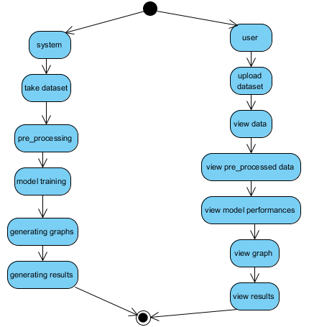

Slide 30
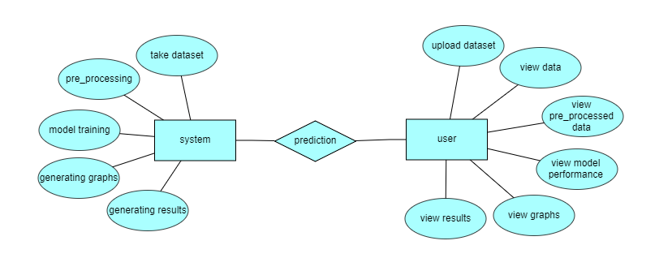
ER Diagram:
An Entity–relationship model (ER model) describes the structure of a database with the help of a diagram, which is known as Entity Relationship Diagram (ER Diagram). An ER model is a design or blueprint of a database that can later be implemented as a database. The main components of E-R model are: entity set and relationship set.

Slide 31
DFD Diagram:
A Data Flow Diagram (DFD) is a traditional way to visualize the information flows within a system. A neat and clear DFD can depict a good amount of the system requirements graphically. It can be manual, automated, or a combination of both. It shows how information enters and leaves the system, what changes the information and where information is stored. The purpose of a DFD is to show the scope and boundaries of a system as a whole. It may be used as a communications tool between a systems analyst and any person who plays a part in the system that acts as the starting point for redesigning a system.

Slide 32
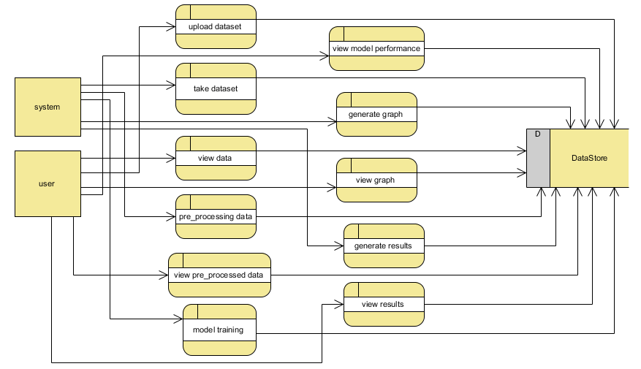
Level 1 Diagram:

Slide 33
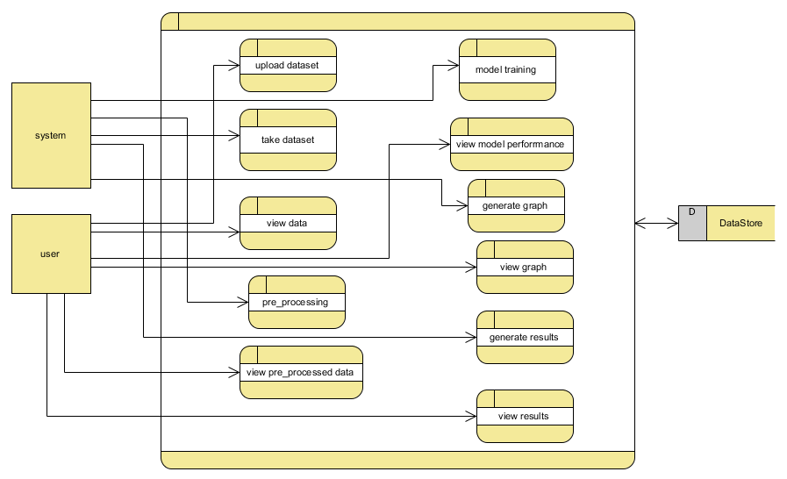
Level 2 Diagram:

Slide 34

RESULTS
HOME PAGE:The homepage provides an interface to upload, preprocess, analyze, and predict datasets related to women's safety on Twitter using machine learning.

Slide 35
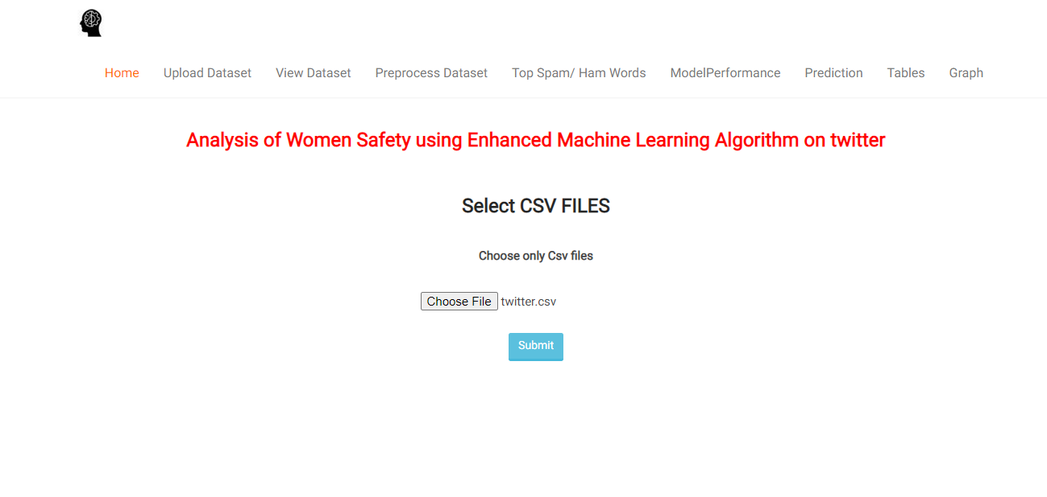
Uploading Dataset: The "Upload Dataset" page allows users to upload CSV files for analysis related to women's safety on Twitter.

Slide 36
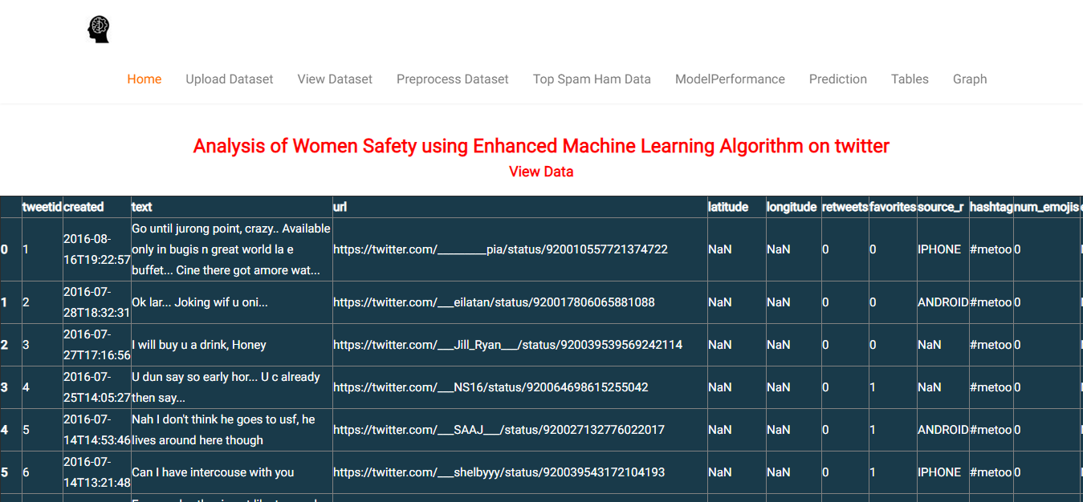
Uploaded Dataset: The "View Dataset" page displays the uploaded dataset in a tabular format for review and analysis. .

Slide 37
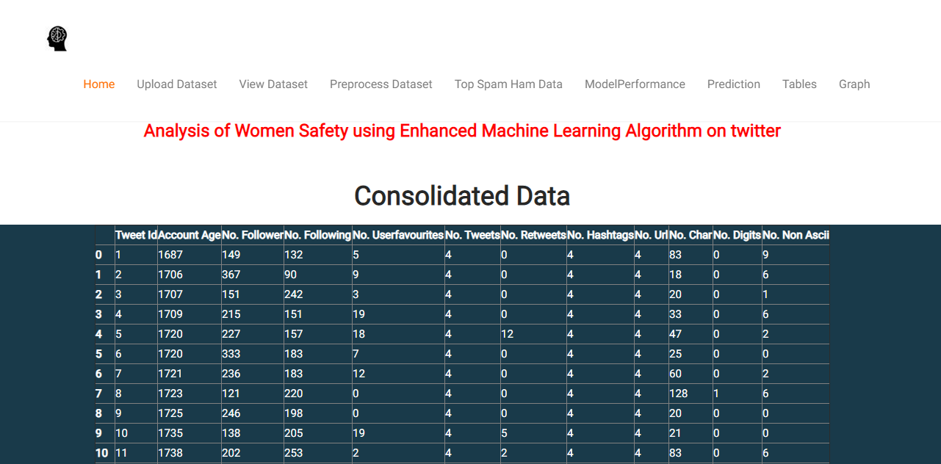
Reading Dataset: dataset with various Twitter metrics foThe "Preprocess Dataset" page displays the cleaned and consolidated r analysis. .

Slide 38
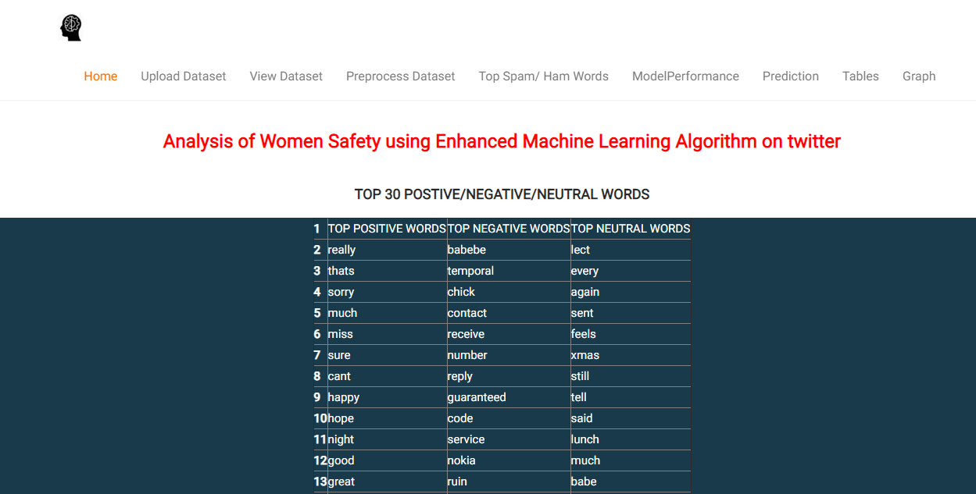
Data Pro-processed: The "Top Spam/Ham Words" page displays the top 30 positive, negative, and neutral words identified from the dataset for spam and sentiment analysis. .

Slide 39
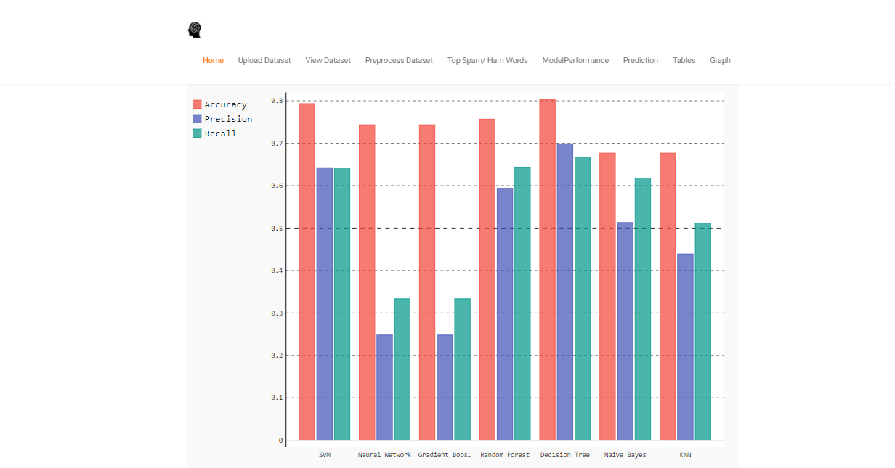
Graph: The "Graph" page visually compares the performance metrics (accuracy, precision, and recall) of various machine learning models using a bar chart.

Slide 40
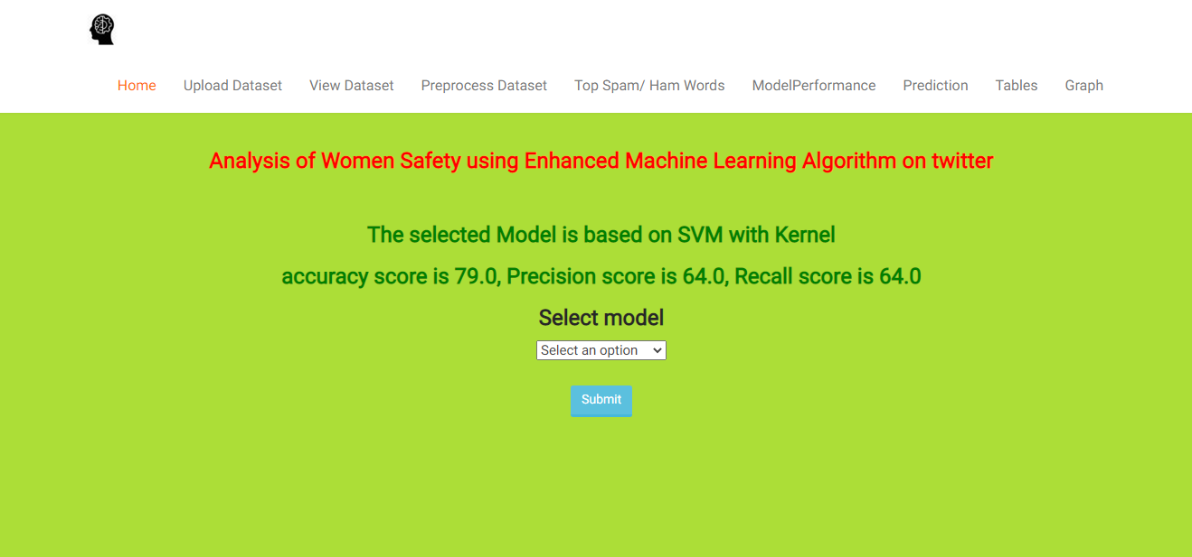
Model performance: SVM: The "Model Performance" page displays the performance metrics (accuracy, precision, and recall) of the selected SVM-based machine learning model.

Slide 41
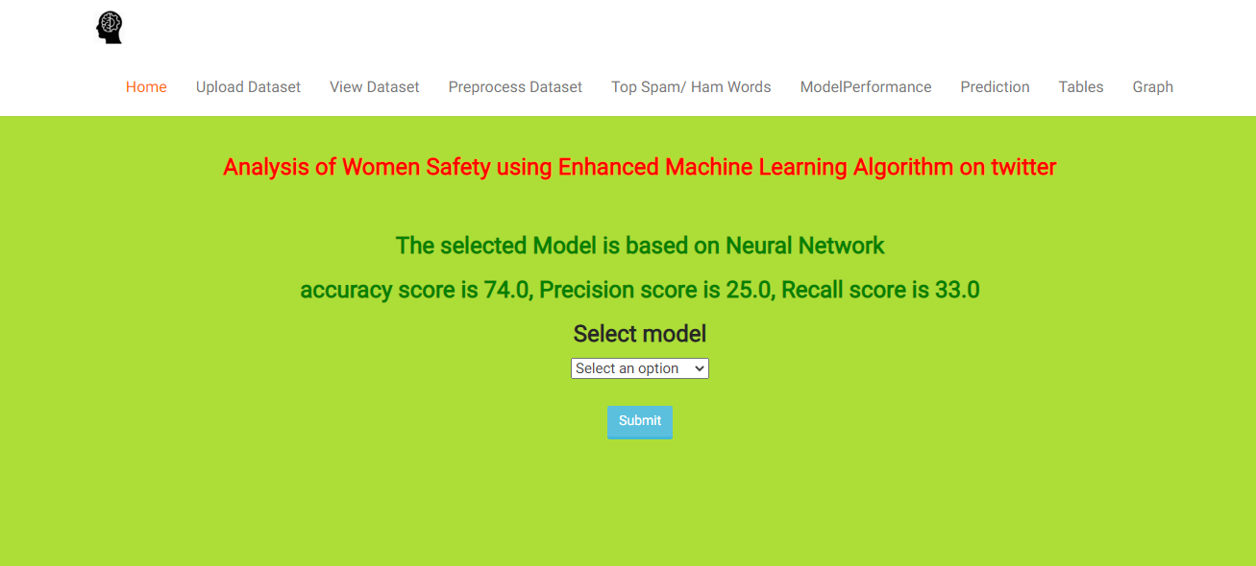
Neural Network: The "Model Performance" page shows the performance metrics (accuracy, precision, and recall) of the selected Neural Network-based machine learning model.

Slide 42
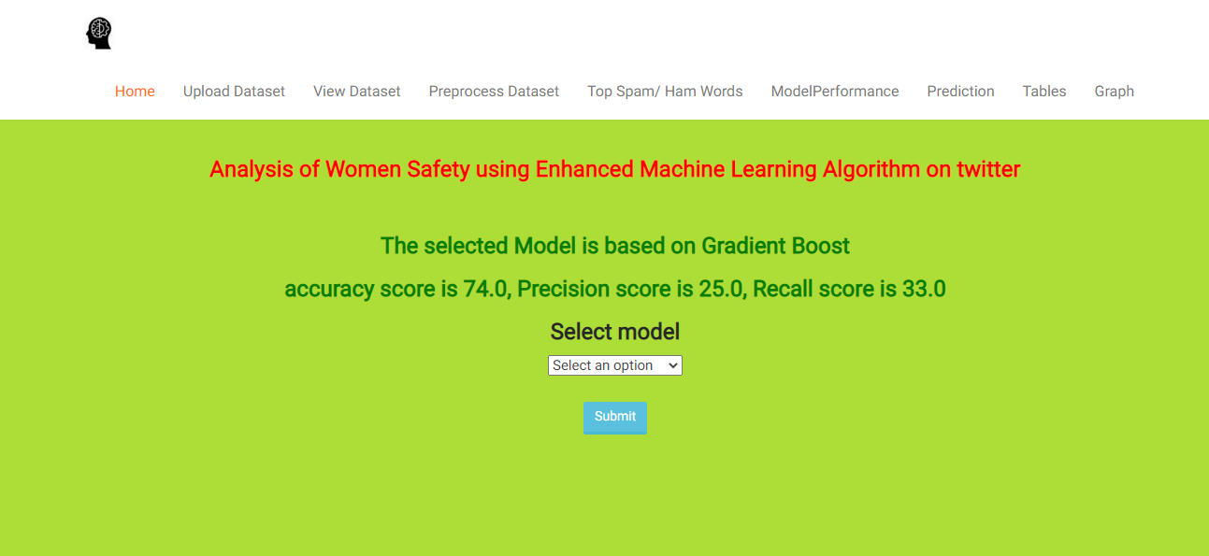
Gradient Boost: The "Model Performance" page displays the performance metrics (accuracy, precision, and recall) of the selected Gradient Boost-based machine learning model.

Slide 43
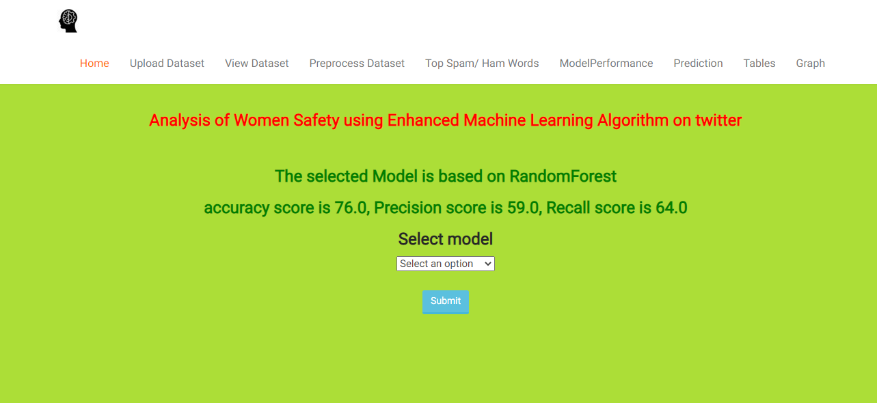
Gradient Boost: The "Model Performance" page displays the performance metrics (accuracy, precision, and recall) of the selected Random Forest-based machine learning model

Slide 44
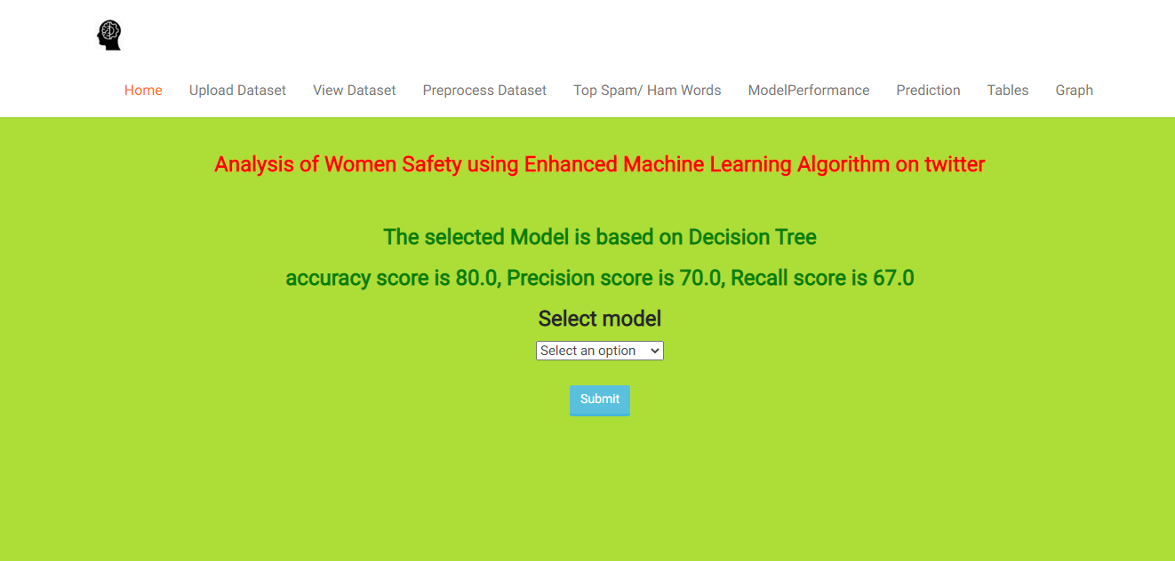
Decision tree: The "Model Performance" page displays the performance metrics (accuracy, precision, and recall) of the selected Decision Tree-based machine learning model.

Slide 45
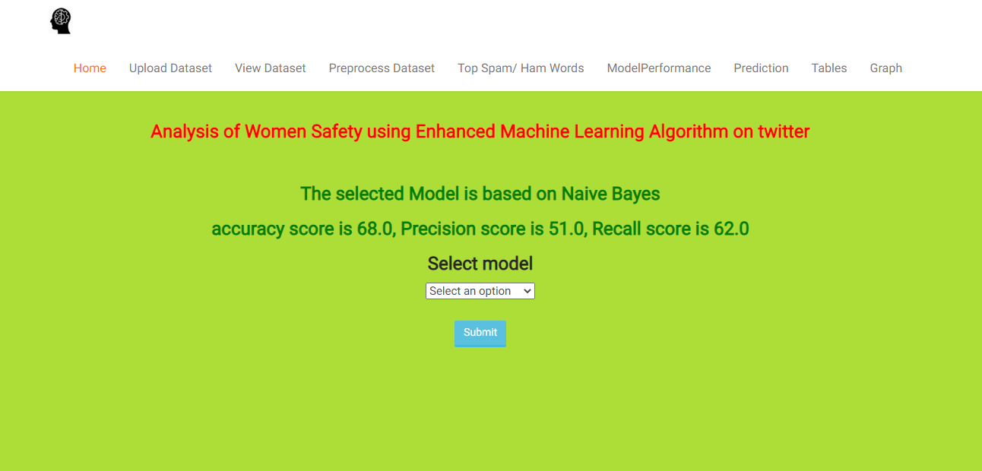
Naïve Bayes: The "Model Performance" page displays the performance metrics (accuracy, precision, and recall) of the selected Naive Bayes-based machine learning model.

Slide 46
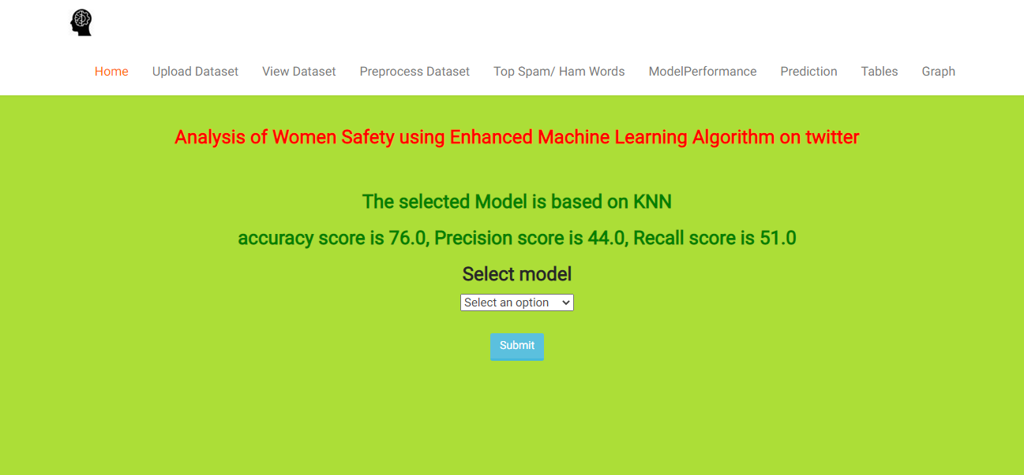
KNN: The "Model Performance" page displays the performance metrics (accuracy, precision, and recall) of the selected K-Nearest Neighbors (KNN)-based machine learning model.

Slide 47
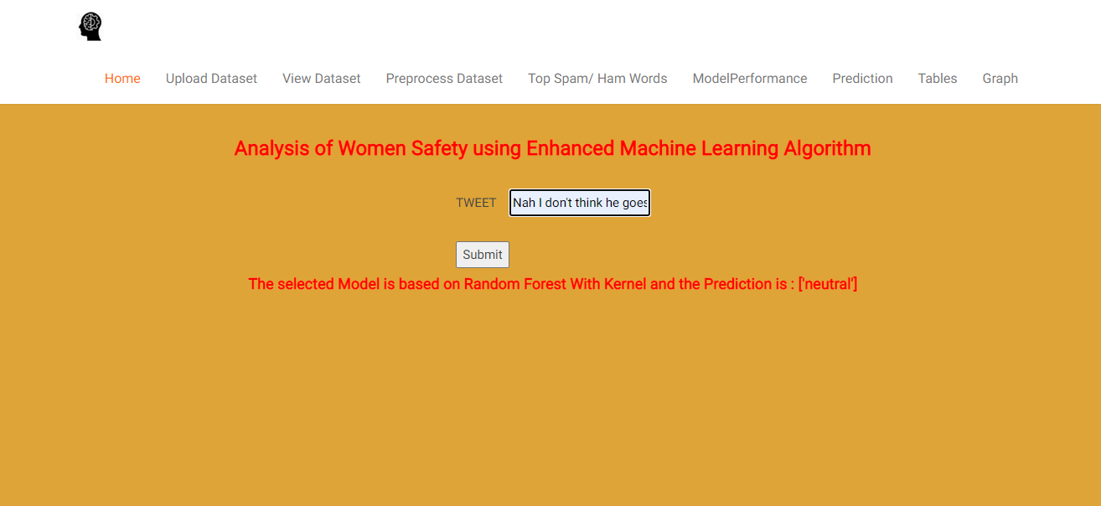
Prediction: Neutral The "Prediction" page allows users to input a tweet, analyzes it using the selected model, and provides a sentiment prediction (e.g., neutral).

Slide 48
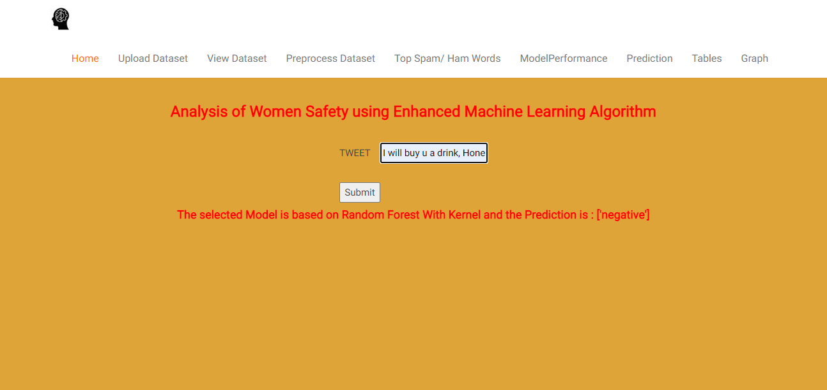
Negative: The "Prediction" page processes an input tweet using the selected Random Forest model and outputs its sentiment classification (e.g., negative).

Slide 49
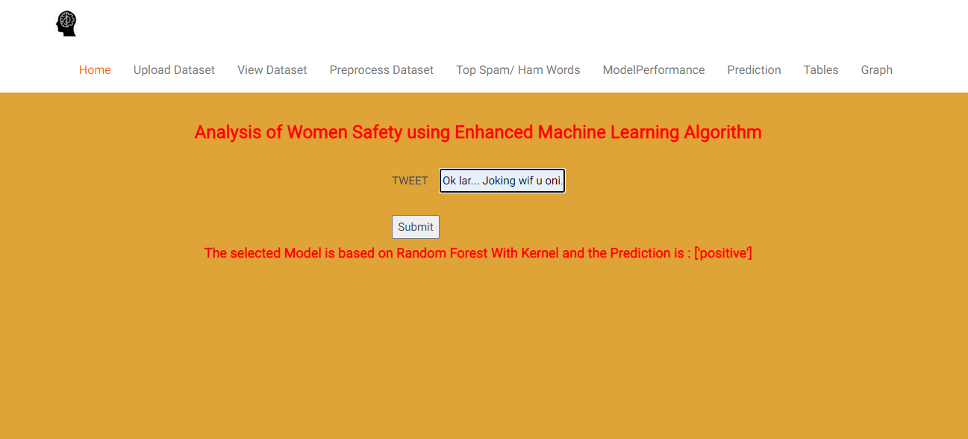
Positive: The "Prediction" page analyzes an input tweet using the selected Random Forest model and provides a sentiment classification (e.g., positive).

Slide 50
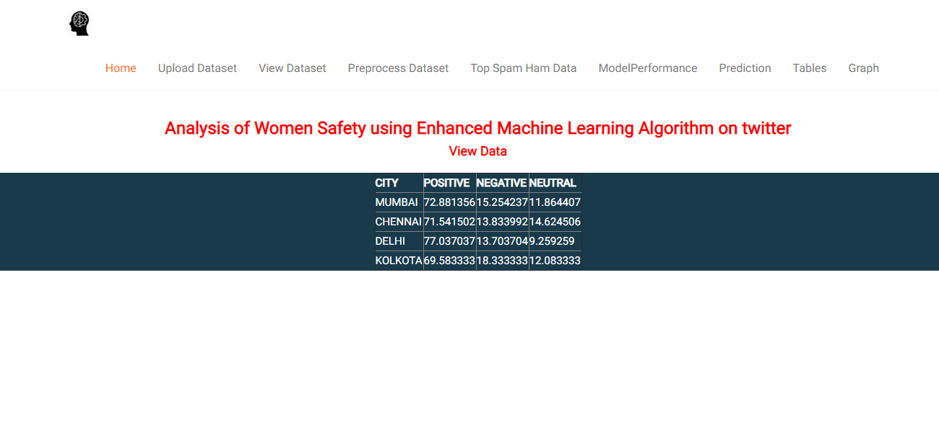
Top five cities classes’ percentage: The "Tables" page displays city-wise sentiment analysis results, showing the percentage of positive, negative, and neutral tweets.

Slide 51
CONCLUSION
Women and girls have been subjected to a great deal of violence and harassment in public areas around the country, ranging from stalking to sexual harassment and assault. This application also focuses on how common Indian people can establish a sense of responsibility on the part of Indian society, so that we can focus on the safety of women in their environment. By using Tweets about the safety of women in India, which frequently include images and text as well as written comments and phrases, we can predict the sentiment of the tweet and use it to analyze the type of tweet. Therefore by interpreting the results we can improve the safety of women.

Slide 52
REFERNCES
Agarwal, Apoorv, Fadi Biadsy, and Kathleen R. Mckeown. "Contextual phrase-level polarity analysis using lexical affect scoring and syntactic n-grams." Proceedings of the 12th Conference of the European Chapter of the Association for Computational Linguistics. Association for Computational Linguistics, 2009.
Barbosa, Luciano, and Junlan Feng. "Robust sentiment detection on twitter from biased and noisy data." Proceedings of the 23rd international www.jespublication.com conference on computational linguistics: posters. Association for Computational Linguistics, 2010.
Bermingham, Adam, and Alan F. Smeaton. "Classifying sentiment in microblogs: is brevity an advantage?." Proceedings of the 19th ACM international conference on Information and knowledge management. ACM, 2010.
Gamon, Michael. "Sentiment classification on customer feedback data: noisy data, large feature vectors, and the role of linguistic analysis." Proceedings of the 20th international conference on Computational Linguistics. Association for Computational Linguistics, 2004.

Slide 53
Charniak, Eugene, and Mark Johnson. "Coarse-to fine n-best parsing and MaxEnt discriminative reranking." Proceedings of the 43rd annual meeting on association for computational linguistics. Association for Computational Linguistics, 2005.
Gupta, B., Negi, M., Vishwakarma, K., Rawat, G., & Badhani, P. (2017). Study of Twitter sentiment analysis using machine learning algorithms on Python. International Journal of Computer Applications, 165(9), 0975-8887
Sahayak, V., Shete, V., & Pathan, A. (2015). Sentiment analysis on twitter data. International Journal of Innovative Research in Advanced Engineering (IJIRAE), 2(1), 178-183.
Mamgain, N., Mehta, E., Mittal, A., & Bhatt, G. (2016, March). Sentiment analysis of top colleges in India using Twitter data. In Computational Techniques in Information and Communication Technologies (ICCTICT), 2016 International Conference on (pp. 525-530). IEEE.

Slide 54
Thank You

